Slide 1
FOMC SENTIMENT INDEX
Ada Kilic
CSCI 6917
Guided Research
August 8, 2023
Notes:
Cover Slide (name, project title, class # &amp; name, date)

Slide 2


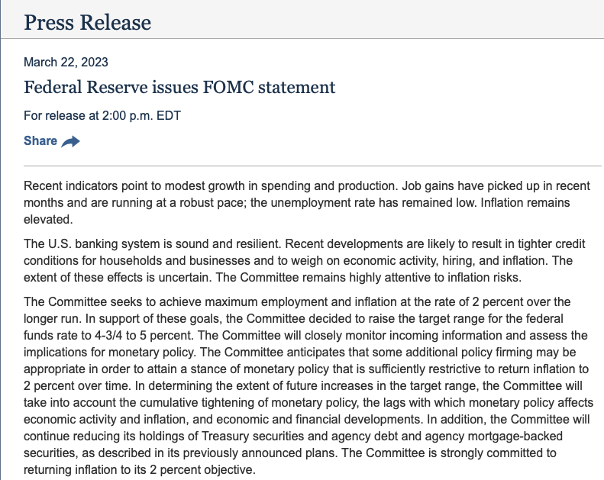
Notes:
What is fomc ?
Slide not counted

Slide 3
Project Objective
This project aims first, to develop a sentiment index for the statements made by the chair of the Federal Reserve Board of Governors after the Federal Open Market Committee (FOMC) meetings; and second, to explore if such a sentiment index can be useful in predicting financial market conditions.
What are you going to do?
This research project builds an index that measures the overall sentiments in one of the most important US economic policy institutions, namely the FOMC meeting statements by implementing a state-of-the art Large Language Model (LLM), namely FinBERT. This index is named the FOMC Sentiment Index (FOMC-SI). FOMC-SI will be used to investigate if the overall sentiment in the FOMC meeting statements can predict economic or market conditions.
How is it done today? Current Limitations?
Currently, there are many studies that use sentiment analysis in various contexts. However, there is not any sentiment analysis designed on FOMC statements.
What is your idea to do something better?
This is the first sentiment index designed for the FOMC statements. Therefore, it will be the only index that can be used to assess the overall sentiment in these policy statements. Designing an FOMC sentiment index will allow users to (i) to assess the overall sentiment among the key monetary policy makers in the US over time; (ii) the index can be used to analyze link between the policy makers’ sentiment and a number of economic and market variables via regressions.
Who will benefit from your work? Why?
Policy makers, central banks, market participants (investment companies, banks, hedge funds, etc.), and researchers in economics and finance…
What risks do you anticipate?
Although FinBERT is trained on a large textual data on economics and finance, the training data may not truly reflect/capture the textual data in FOMC policy statements as these policy statements generally contain specific jargons and hence, the context may not be clearly understood by the model.
Out of pocket costs? Complete within 11 weeks?
This project is feasible within the given time-frame. I decided to do sentiment analysis instead of topic modeling in order to finish within 11 weeks and also decided not to re-train the model.
Notes:
Project Objective(1):
Few bullets on what you tried to do/did
Brief answers to Heilmeier Questions

Slide 4
Technical Approach: Key Steps
1
2
3
4
5
6
DATA COLLECTION
PREPROCESSING
FOMC INDEX CONSTRUCTION
QUALITATIVE & QUANTITATIVE REVIEW
SENTIMENT ANALYSIS & AVERAGING
ANALYSIS & INTERPRETATION OF RESULTS
For the FOMC-SI:
- The textual sample data for statements for this project covers all the available statements text made by the FOMC since 2000.
- The data collected has 202 statements corresponding to the period between January 2000 and June 2023.
- Cleaning and preprocessing text data is an important step before performing
sentiment analysis.
- Splitting sentences for a given statement text.
- Tokenization: This process breaks the text into individual words or tokens.
- Use FinBERT’s sentiment outcomes with their corresponding probabilities and construct a compound score to assign a numeric value of sentiment for each sentence in a FOMC statement.
- Assign 0 weight to “neutral” outcome, and -1 and 1 to negative and positive outcomes, respectively.
- FOMC-SI for a given meeting statement date is the negative of the sum of positive and negative probabilities divided by the number of sentences for a given statement date.
- FOMC-SI will be between -1 and +1
- Read papers that explains and discusses BERT and FinBERT and reviewed a subset of the statements for understanding the context.
- FinBERT is designed to conduct sentiment analysis of Financial text based on pre-trained language models. Results are a numerical score representing the sentiment conveyed in the text.
- FinBERT produces five sentiment values. Three values represent the probabilities that the text is either positive, negative, or neutral.
- FinBERT also calculates a compound score as the positive probability minus the negative probability.
- FinBERT provides trinary sentiment prediction which is based on the highest of the three probabilities.
- Results are discussed in future slides.
- The index is interpreted and linked to economic recessions and inflationary periods.
- The index is used to predict future market risk or fear in an application.
Notes:
These Last Heilmeir Questions are answered in this slide
Midterm results?
By midterm I will be done with data cleaning and data preprocessing. I could also potentially have should have sentiment values.
Final Demonstration?
By the final demonstration I will be able to display all my results from my research. I plan to average sentiment values of each sentence in each of the policy statements and hence, construct a historical index of FOMC sentiment index.
3. Technical Approach (4) Key steps in research: what did you do
What is innovative about your research (2)
Architecture diagram – key items labeled

Slide 5
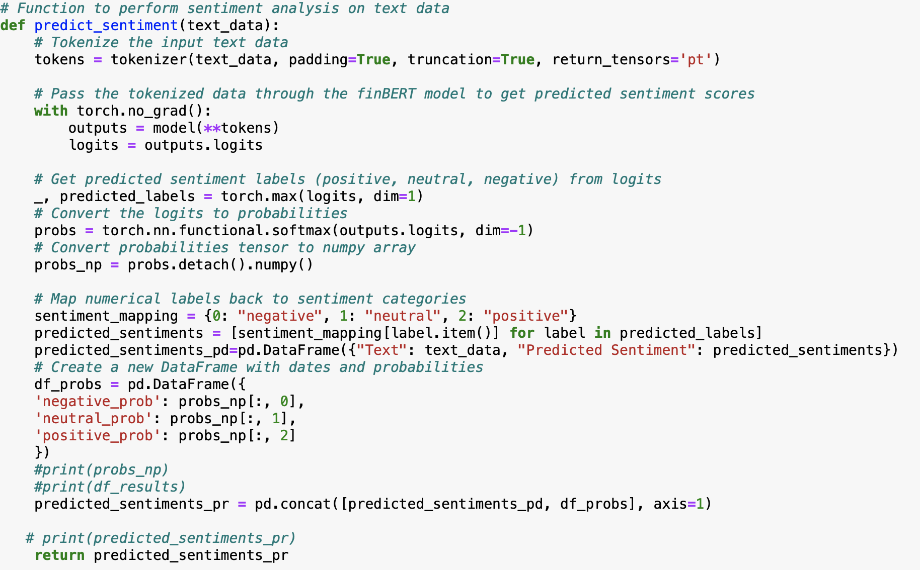
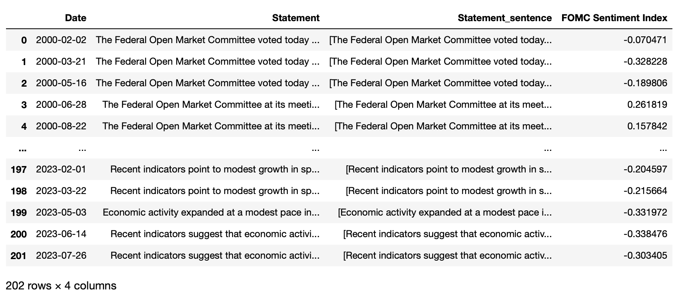
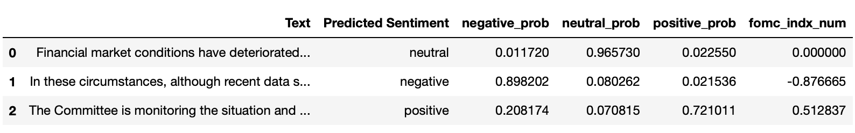
Technical Approach: Architecture
Function that Implements FinBERT
2) Function that Calculates the Index
if __name__ == "__main__":
fomc_si = []
for value in text_data:
text_i = value
#print(text_i)
predicted_sentiments = predict_sentiment(text_i)
predicted_sentiments['fomc_indx_num'] = np.where(predicted_sentiments['Predicted Sentiment']== 'neutral', 0, -1*predicted_sentiments['negative_prob'] + 1*predicted_sentiments['positive_prob'])
fomc_si.append( -predicted_sentiments['fomc_indx_num'].mean())
4) FOMC Sentiment Index
3) FinBERT Outputs

Slide 6

Research & Innovation
This project is novel in a number of fronts:
This is the first project that designs a sentiment index for one of the major policy statements in the US.
It implements FinBERT that is based on BERT, a LLM on a textual data that is very specific in nature and drafted to reflect policy decisions and associated analysis of economic and financial conditions with specific jargons and language.
It is a precursor to potentially a much larger project as it can lead to the development of Federal Reserve Board’s and similar policy institutions development of their own LLMs.
Provides an index that can be used as a tool for assessing the overall sentiment of FOMC members and provides a comprehensive view of sentiment trends over time. This can allow for potentially revealing patterns related to economic conditions and policy decisions.
The Index can be used to build predictive models that can link it to economic and market conditions and variables.

Slide 7
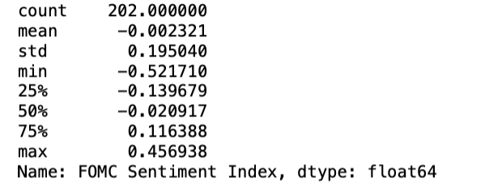
Results: Description of FOMC Sentiment Index
FOMC-SI Summary Statistics:
By construction, the index is between [-1, 1]
A sentiment index of -1 means an extremely positive sentiment.
A sentiment index close to +1 means a very negative sentiment.
A sentiment index close to 0 means a neutral sentiment.
The index range is between -0.52 and +0.46.
Average for the entire history of statements is -0.002 which is close the a “neutral” sentiment!

Slide 8
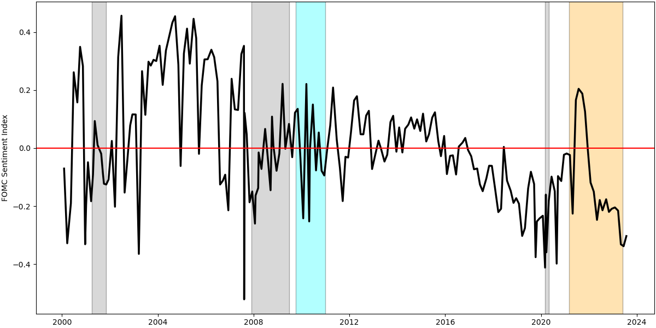
Results: FOMC Sentiment Index Over Time
KEY:
FOMC Index: Positive -> Negative Sentiment;
Negative -> Positive Sentiment
US Recessions
European Debt Crisis
Post Covid Inflationary Period
Notes:
4. Results (1)
Show and explain results – how do they show what
you accomplished

Slide 9
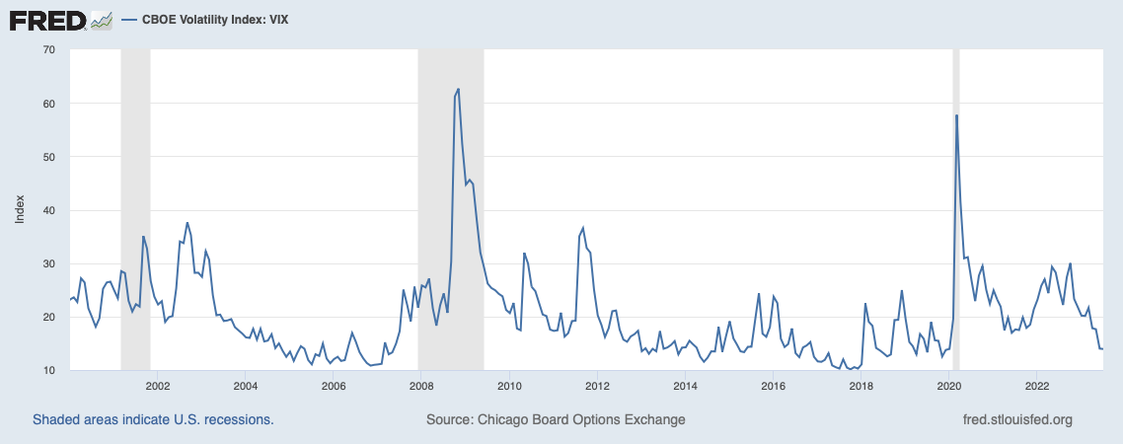
Application: Can FOMC-SI Predict VIX?
This application explores if the FOMC-SI can be useful in predicting economic and financial conditions.
To this end, the index is used to assess if it can predict future values of VIX.
The VIX Index, often referred to as the "fear gauge," is a measure of expected price fluctuations in the S&P 500 Index options over the next 30 days.
The Chicago Board Options Exchange (CBOE) introduced the VIX Index in 1993, and it has since become one of the most recognized measures of market volatility.
The VIX also reflects how much risk is accumulated in the markets and used often by market participants and economic policy makers to get a sense of overall market sentiment and risk.
The VIX index generally increases during recessions and bad economic periods as can be seen in the figure.

Slide 10
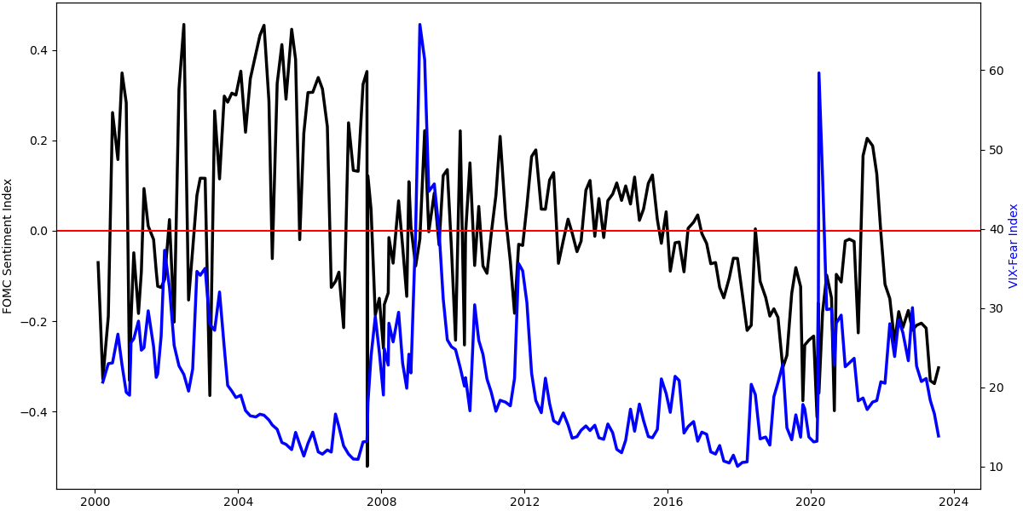
Application Results: FOMC Sentiment Index - VIX-Fear Index
Collected daily VIX index from Bloomberg and calculated average VIX in between the FOMC statement dates for this analysis.
The figure displays FOMC-SI together with the average VIX for the FOMC statement periods.
Inspection of the plots reveals:
FOMC-SI generally high (sentiment in FOMC statements are more negative) during periods when VIX is low.
This seemingly counterintuitive observation in fact may not be that counterintuitive.
Because, during episodes of low VIX, the markets are calm and risks tend to accumulate gradually and hence, FOMC member having considerable information about the markets and economic conditions are more cautious and possibly has more negative sentiments reflected in the statements.

Slide 11
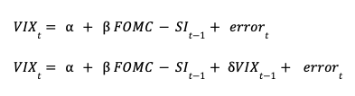
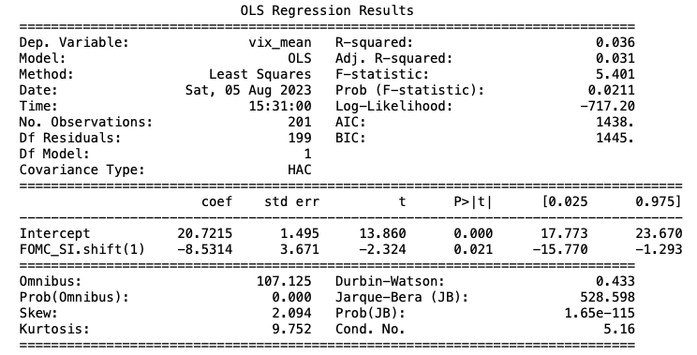
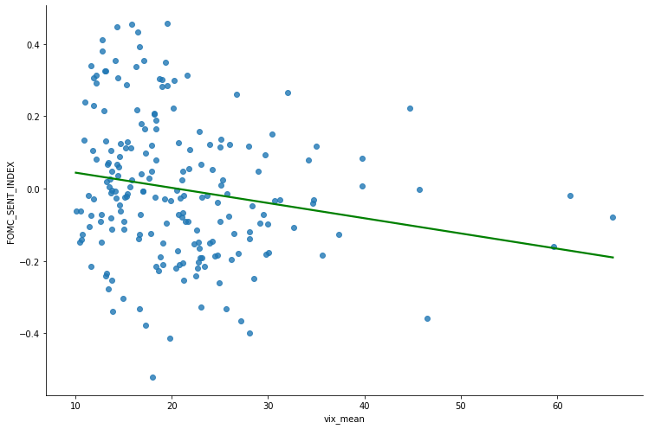
Results: Regression Analysis with FOMC-SI
Run two regressions.
(1) First model regresses VIX on statement date t on a constant and FOMC-SI on the previous statement date (i.e., at date t-1).
Results are reported in the Table.
This models indicates a statistically significant coefficient for FOMC-SI (-8.531) with a p-value of 0.021 less than 0.05.
This shows that the FOMC-SI is statistically significant and negative and hence, statistically predicts the future average value of VIX!
As the displayed scatter plot with the fitted regression line show, higher average VIX tends to associate with lower FOMC-SI (i.e., positive sentiment in the statements).

Slide 12
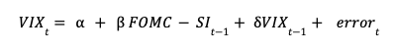
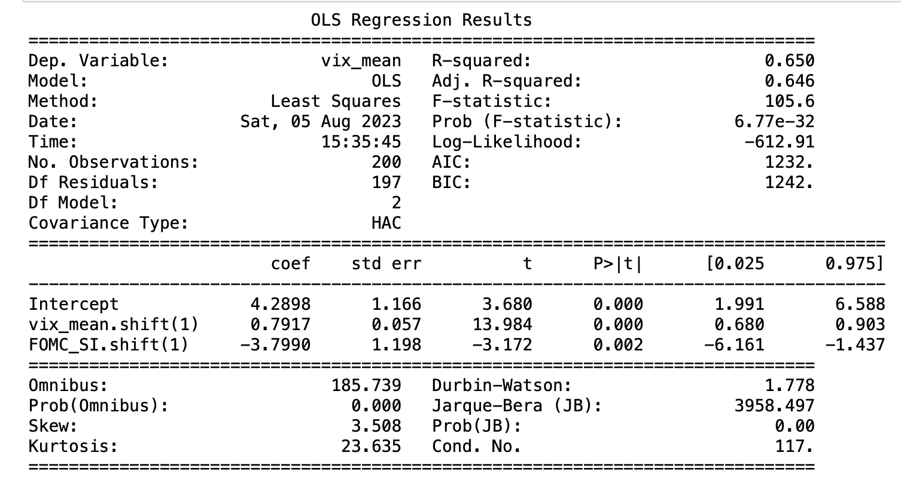
Results: Regression Analysis with FOMC-SI
(2) The second model augments the first regression by also including the lagged VIX to control for the inertia high VIX periods usually followed by a period of high VIX or low VIX periods usually followed by a period of low VIX as can be observed from the figure on slide 11.
Like the first model, this second model also indicates a statistically significant coefficient for FOMC-SI (-3.800) with a p-value of 0.002 and hence, the statistical significance of FOMC-SI in predicting the future average value of VIX!
Results for this model suggests that even after controlling for the persistence in VIX, FOMC-SI is statistically significantly negative and predicts next statement period’s average VIX.
Results from both models are promising and shows that additional work with different economic and financial market variables such as unemployment rate, GDP growth, or inflation may be useful.

Slide 13

Conclusion
Developed a sentiment index to gauge the overall sentiment in one of the major policy statements in the US.
Developed a jupyter notebook that can be used to implement FinBERT in a given text data and implemented it to calculate FOMC-SI for each FOMC meeting date.
FOMC-SI is calculated with all the publicly available FOMC statements and hence, historical evolution of the sentiment can be analyzed.
Applied FOMC-SI to an important market fear gauge, namely VIX and showed that the FOMC-SI can predict future value of VIX!
Notes:
5. Conclusion (1)

Slide 14
Create a sentiment analysis model trained on more relevant financial text.
Training a domain-specific sentiment analysis model using financial data can potentially lead to more accurate and contextually relevant sentiment predictions for financial documents like FOMC speeches, economic reports, company earnings calls, news articles, and social media posts related to the financial market.
This will allow for a more accurate and contextually meaningful sentiment analysis tool for financial applications.
Suggest a project that develops Federal Reserve’s own LLM training as the text data in policy institutions can be different from the text data BERT and FinBERT as well as other LLMs are trained on.
Future Work
Notes:
Future Work

Slide 15
THANK YOU!

